Slide 1




AT82.02
Data Modeling and Management
Unit 0: Introduction
Chutiporn Anutariya (chuti at ait dot ac dot th)

Slide 2

?
WARM UP Discussion:
Data …
What are you thinking of when we talk about data?
2

Slide 3
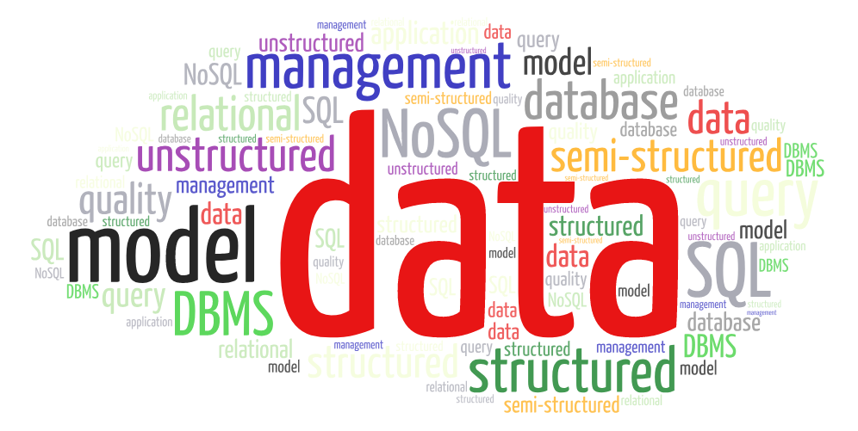
3

Slide 4

Let’s Discuss:
Sources of Data …
Where do data come from?
Who/what generates data?
4

Slide 5








Three major sources of data...
Machines
Data generated from real time sensors, machines, vehicles, web logs, etc.
People
Tweets, status updates, social media data, photos, videos
Organizations
More traditional type of data: transaction information, databases, data warehouses
5

Slide 6
Data Management
Perspectives & Contexts
6

Slide 7
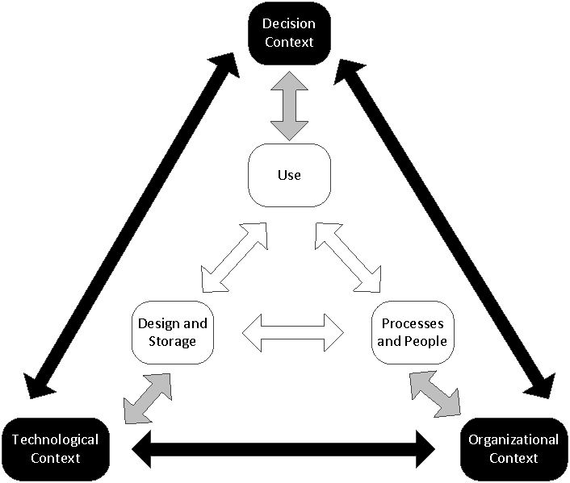
Data Management: Perspectives & Contexts
7

Slide 8
Business-Oriented Perspective
Decision Context (What?)
How can business goals be quantified? What decisions need to be made?
What is the impact of decision on revenue enhancement, cost reduction, and risk management?
What needs to be done to enhance the effectiveness of decision making?
Technological Context (How? When? Where?)
Does the technology for decision making need to be centralized or decentralized?
What technology is required that would support the requisite immediacy in decision making?
How do different tools support clarification of assumptions in decision making?
Organizational Context (Who?)
Who are the key constituents in decision making?
What are the beliefs and culture that can influence decision making?
How do regulations influence decision-making?
8

Slide 9
Data-Oriented Perspective
Use
Access
Operational
Reconciled
Big Data
Analysis
Predictive Analysis
Forecasting
Simulation
Optimization
Text analytics
Web Analysis
Social Network Analysis
Delivery
Dashboard
Design and Storage
Processes and People

Slide 10
Data-Oriented Perspective
Use
Design and Storage
Data Acquisition and Lifecycle Management
Data Storage Management
Metadata Management
Master Data Management
Data Quality Management
Data Integration
Processes and People
Who holds decision rights for various data decision domains? What skills are required to better use data? What skills are the training-related requirements that would enable desirable uses of data?
What processes need to be designed to enable desirable uses of data? Who owns the data?
What are the acceptable processes of data uses? How to ensure and monitor data-related regulations? How is data inventoried?

Slide 11
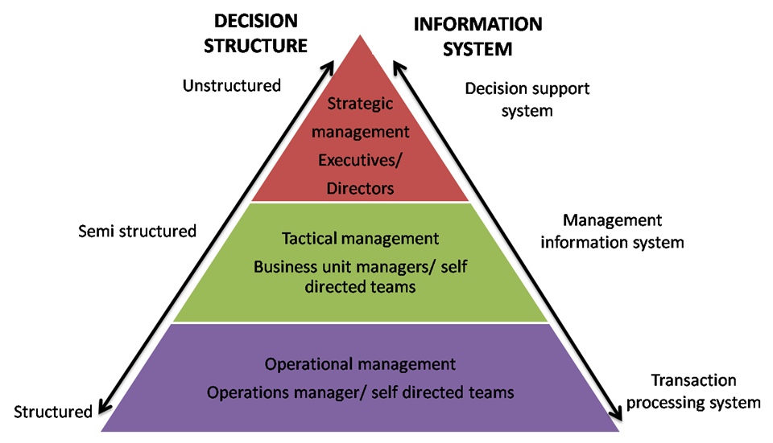
Decision Making in Enterprises

Slide 12
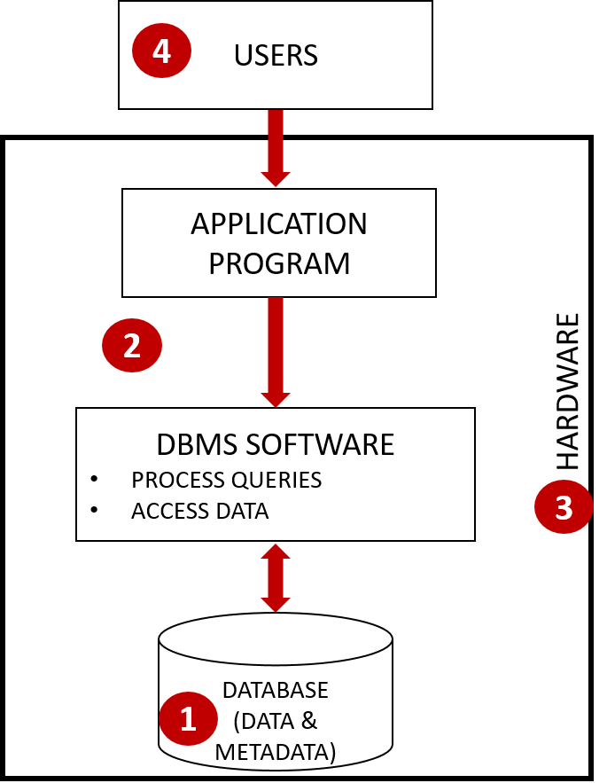
OLTP: Online Transaction Processing Database System Components
12

Slide 13





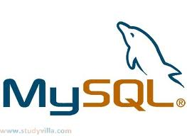

Top Enterprise Relational DBMS
13

Slide 14
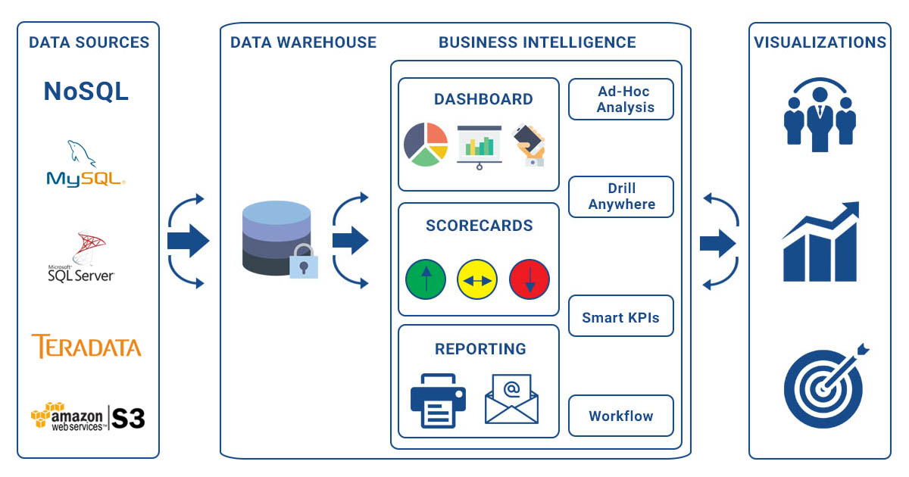
Business Intelligence Stack
14

Slide 15
Let’s Discuss:
What is a Data Model?
Why do we care about data model?
15

Slide 16
Data Model
describes data characteristics
16

Slide 17
Data Model describes data characteristics
Structure
Operations
Constraints
17

Slide 18
Data Model describes data characteristics
Structure
Operations
Constraints
Employee {
firstName: string,
lastName: string,
DOB: date
}
Select employee whose DOB is after 1990.
Today’s date minus DOB must be greater than 20.
18

Slide 19
Data Model Structures
Structure
Unstructured
Structured
Semi-structured
19

Slide 20
Data Model Structures
Structure
Structured
The data that has a structure, is typed and is well organized either in the form of tables or in some other way.
It has a high level of organization making it predictable, easy to organize and very easily searchable using basic algorithms.
Unstructured
Semi-structured

Slide 21
Data Model Structures
Structure
Structured
Unstructured
The data that is unstructured or unorganized.
Operating such type of data becomes difficult and requires advance tools and softwares to access information.
Semi-structured

Slide 22
Data Model Structures
Structure
Structured
Unstructured
Semi-structured
Semi-structured data lies somewhere between the two.
It is a form of structured data that does not conform with the formal structure of data models associated with relational databases or other forms of data tables
But contains tags or other markers to separate semantic elements and enforce hierarchies of records and fields within the data.
It is also known as self-describing structure.

Slide 23
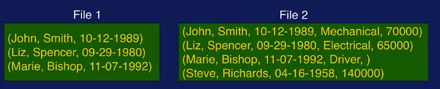
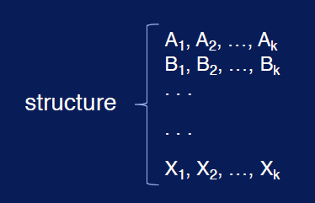
Data Model Structures
Structure
Structured?
Unstructured?
Semi-structured?
Are the files structured?
Do they have the same structure?

Slide 24
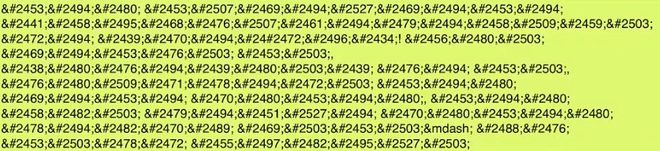
Data Model Structures
Structure
Structured?
Unstructured?
Semi-structured?
Is the file structured or unstructured?
Compressed data like JPEG images, MP3 audio files, MPEG3 video files, encrypted data, are usually ___________.

Slide 25
Data Model Operations
Operations
Subsetting
Substructure extraction
Union
Join

Slide 26
Data Model Operations
Operations
Subsetting: Given a collection of data, and a condition, find a subset of data from the collection so that each
element in the subset satisfied
(John, Smith, 10-12-1989, Mechanical, 70000)
(Liz, Spencer, 09-29-1980, Electrical, 65000)
(Marie, Bishop, 11-07-1992, Driver, )
(Steve, Richards, 04-16-1958, 140000)
Field#5 < 90000
(John, Smith, 10-12-1989, Mechanical, 70000)
(Liz, Spencer, 09-29-1980, Electrical, 65000)

Slide 27
Data Model Operations
Operations
Substructure extraction: Given a data collection with some structure, extract from each data item a part of the structure as specified by a condition.
(John, Smith, 10-12-1989, Mechanical, 70000)
(Liz, Spencer, 09-29-1980, Electrical, 65000)
(Marie, Bishop, 11-07-1992, Driver, )
(Steve, Richards, 04-16-1958, 140000)
Field#1, Field#2
(John, Smith)
(Liz, Spencer)
(Marie, Bishop)
(Steve, Richards)

Slide 28
Data Model Operations
Operations
Union: Given two data collections, create a new one with
elements of the two input collections. Duplicate elimination.
(John, Smith, 10-12-1989)
(Liz, Spencer, 09-29-1980)
(Marie, Bishop, 11-07-1992)
(John, Smith, 10-12-1989)
(Liz, Spencer, 09-29-1980)
(Marie, Bishop, 11-07-1992)
(Lance, Holt, 04-02-1976)
(Lance, Holt, 04-02-1976)
(Liz, Spencer, 09-29-1980)

Slide 29
Data Model Operations
Join: Given two data collections, create a new one with
elements of the two input collections. Duplicate elimination.
(12, John, Smith, 10-12-1989)
(14, Liz, Spencer, 09-29-1980)
(18, Marie, Bishop, 11-07-1992)
(20, Sue, Daveson, 03-16-1986)
(12, John, Smith, 10-12-1989, Mechanical,
70k)
(14, Liz, Spencer, 09-29-1980, Electrical, 65k)
(18, Marie, Bishop, 11-07-1992, Driver, 45k)
(12, Mechanical, 70k)
(14, Electrical, 65k)
(18, Driver, 45k)
(23, Student, 30k)

Slide 30
Data Model Constraints
Constraints
Constraints are logical statements that must hold for data.
Different data models have different ways to express constraints
A movie has only one title

Slide 31
Data Model Constraints
Constraints
Types of Constraints
Value constraint
Age is never negative
Uniqueness constraint
A movie can have only one title
Cardinality constraint
A person can take between 0 and 3 blood pressure medications at a time

Slide 32
Data Model Constraints
Constraints
Types of Constraints
Type constraint
Lname:string
Domain constraint
Month in (1 … 12) or Month in (‘Jan’, ‘Feb’, … ‘Dec’)
A structural constraint puts restrictions on the structure of the data rather than the data values themselves.

Slide 33
Different Kinds of Data Models
List some data models you are aware or have heard of?

Slide 34
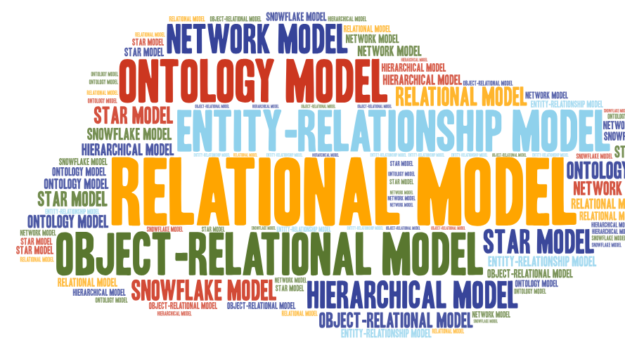

Slide 35
Semi-structured Data Model
Data Model behind the Web
35

Slide 36
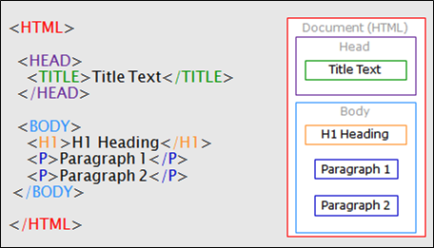
A Simple HTML Document

Slide 37
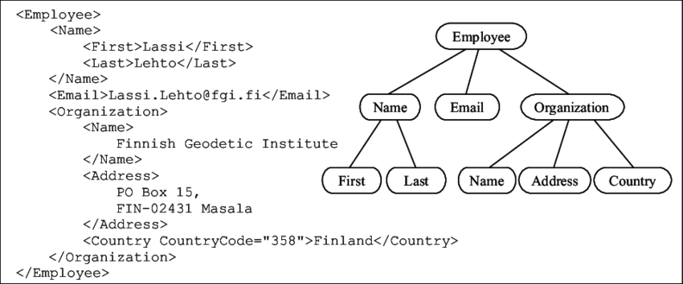
XML: A Generalization of HTML
XML Data Processing allows query related to both element structures and values.

Slide 38
JSON: Java Script Object Notation
An open standard format that uses human-readable text to transmit data objects consisting of attribute–value pairs.
It is used primarily to transmit data between a server and web application, as an alternative to XML.
JSON has been popularized by web services developed utilizing REST principles.

Slide 39
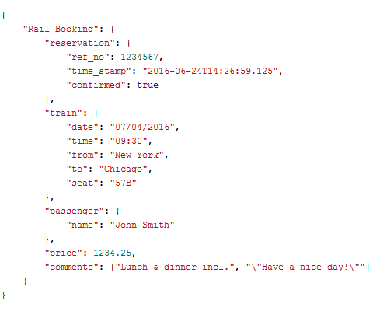

JSON: Java Script Object Notation
Key-value Pair
Tuple / Object
Array

Slide 40
?
How to generalize all these forms of semi-structured data?
40

Slide 41
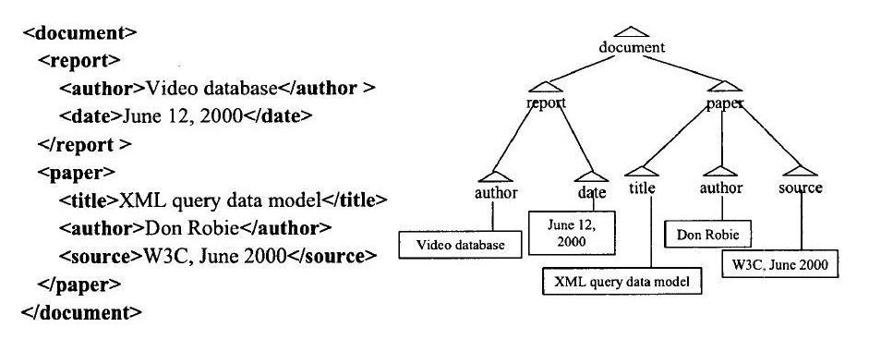
Tree Data Structure
A tree has a nested and hierarchical structure representing complex relationships between entities!

Slide 42
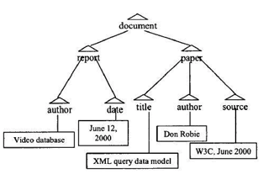
Tree Data Structure
Tree is well-known data structure and allows navigational access to data
Paper
getParent → document
getChildren → title, author, source
getSibling → report
“Video database”
Root-to-Node path → document/report/author/“video database”
Queries need tree navigation
Author of “XML query data model”

Slide 43
Let’s Discuss: Utilization of XML or JSON on the Internet
XML (and its lightweight younger sibling JSON) often gets referred to as "the language of the Internet". That means Web applications talk to each other in XML or JSON. For instance, they are used to "markup" vast amount of big data on the Internet for access and retrieval by programs running in applications. They are also used to send messages through which that programs can talk to each other.
An example application would be a program using an XML-based data standard which defines a common way of describing the news items. This application can use XML (or JSON) to gather news data from multiple web sources and aggregate them in a news portal for the readers.
Think of other applications that can use XML and discuss it with your fellow class mates.

Slide 44
Evolution of data models
least
1960
Hierarchical
Difficult to represent M:N relationships (Hierarchical only)
Physical level dependency
No ad hoc queries
Access path predefined (navigational access)
1969
Network
Semantics in Data Model
Provides ad hoc queries
Set-oriented access
Weak semantic content
1970
Relational
1976
Entity Relationship
Easy to understand
Incorporates more semantics
1976
1978
Semantic
More semantics in data model
Support for complex objects
Inheritance
Behavior
1985
1990
Object-Oriented
Extended Relational (Object/Relational)
most
Address Big Data problem
Less semantics in data model
Based on schema-less key-value data model
Best suited for large sparse data stores
2009
Big Data
NoSQL

Slide 45
Data Management & Database Technology
45

Slide 46
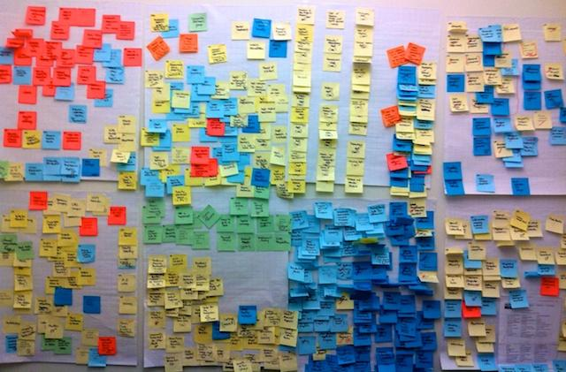

How to Manage Data

Slide 47
Database
Collection of related data
Data: known facts that can be recorded and that have implicit meaning
Represents some aspect of the real world
Built for a specific purpose

Slide 48
Importance of Database Technology
Crucial for daily operations and decision making in organizations
Database management technology
Major part of software industry
Revolutionary evolvement over 40 years
Foundation for management of long-term memory of organizations
Vibrant field with employment opportunities

Slide 49

Thank you.
Exit Slip:
Discuss 3 important things / concepts we have learned today.

